Slide 1
Clothing recommendation System
Group 17:
Akshat kumar
Aarti Mankani
Ajinkya patankar

Slide 2
Data
Amazon’s Women Apparel Data from Kaggle.
Data consists of 183138 data points and 19 features
Features taken into consideration:
asin ( Amazon standard identification number)
color ( Color information of the clothes)
brand (brand of the product)
product type name
medium image url (url of the image)
title (title of the product)
Formatted_price (price of the product)

Slide 3
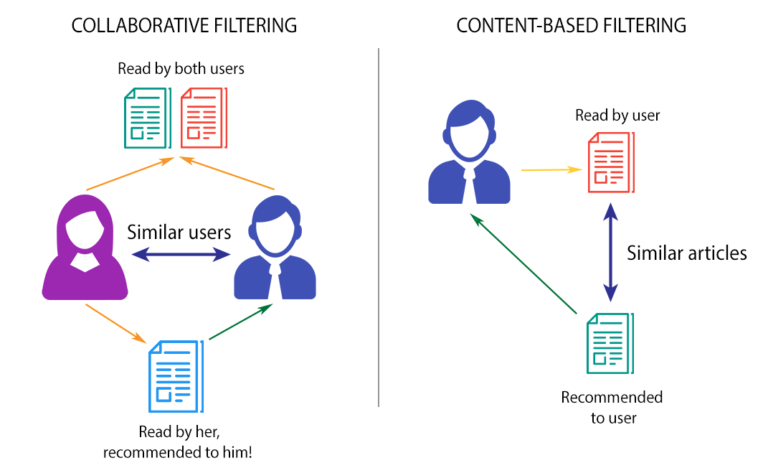
Problem statement
Recommendation Systems help filter, prioritize and efficiently deliver relevant information.
Two Types of Recommendations:
Collaborative
Content Based
Most Recommendation Systems are dependent on User Ratings.
We focus on an advanced recommender system based on the visual and textual representation of the product
Extracted valuable features of the products that are not possible with a conventional recommender system

Slide 4
Proposed Model
Clothing Recommendation System which uses the following models to recommend items most similar to selected items:
VGG CNN – For Visual Properties of Product
TF-IDF – For Textual Properties of Product
Bag of Words – For Textual Properties of Product

Slide 5
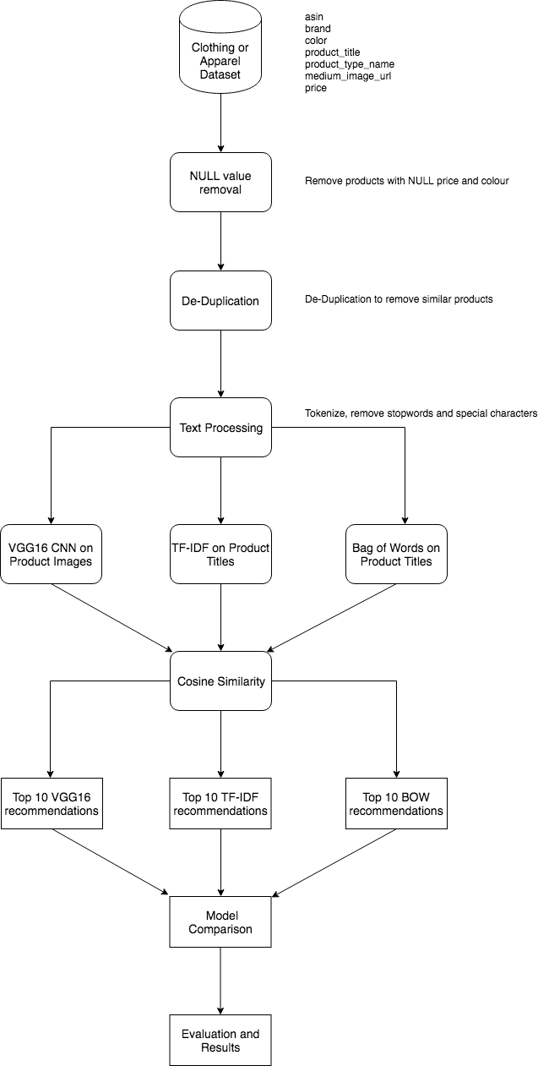
Flow Diagram

Slide 6
Pre-processing
Removal of NULL values for rows with:
No product price
Very short Descriptions
Removal of Duplicates for:
Rows with Duplicate titles
E.g Nike Stripes Women’s Shirt X-Large & Nike Stripes Women’s Shirt Small
Text Processing by tokenization, removal of stop words and special characters

Slide 7
RECOMMENDATION USING Product Image
Obtain vector representation of product images by doing feature extraction
VGG-16 multi-layer neural network model designed to extract features from images
Vector of size ~25k obtained for each image
Pairwise distance using cosine similarity.
Sort items in decreasing order of similarity
Recommend top 10 items
Average Euclidian distance to check accuracy

Slide 8
Recommendation Using Product Title
Obtain vector representation of product titles
TF-IDF and Bag of Words used for this task
TFIDF - how important a word is to a document in a collection or corpus.
Bag of Words – Represent by word count and disregarding the order of appearance
Vectors converted to equal length for comparison
Cosine similarity, sorting, recommendation and average Euclidian distance

Slide 9
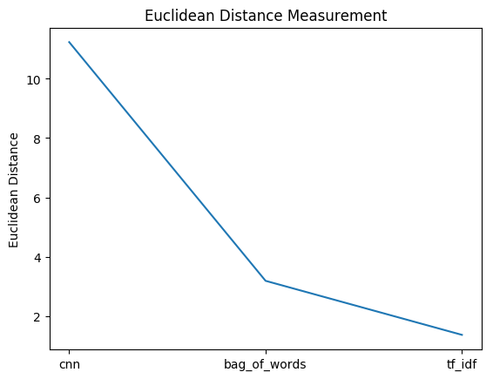
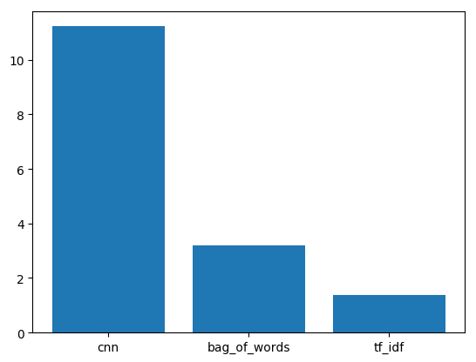
model comparison
Used Euclidean Distance for Model Comparison
Lower the Euclidean Distance, better the performance
Lowest for TF-IDF
Highest for VGG CNN

Slide 10
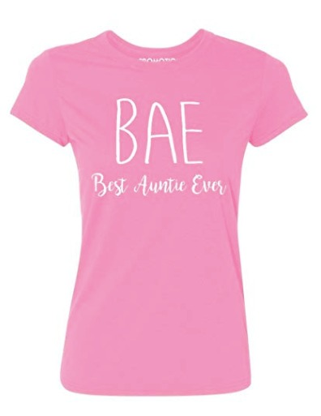
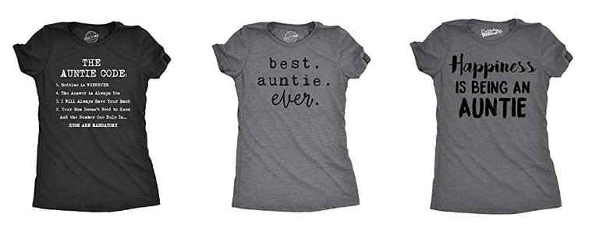
Recommendation Example

Slide 11
Conclusion
We built a Recommendation System which extracts features from products visual and textual properties.
Used VGG CNN for product image and TF-IDF and Bag of Words for product title.
Performance Rating:
TF-IDF
Bag of Words
VGG CNN

Slide 12
future work
Introduce ResNet CNN for Recommendation using visual properties
Introduce Word2Vec for Recommendation using textual properties
Scale up the system by using additional data by using Apache Spark
Investigate the trend of time complexity by increasing the number of nodes in the cluster

Slide 13
references
[1] F.O.Isinkayea Y.O.Folajimib B.A.Ojokohc Recommendation systems: Principles, methods and evaluation 2015
[2]Xinjuan Zhu ; Junfang Huang ; Yang Qi An Apparel Recommender System Based on Data Mining
[3] Greg Linden, Brent Smith, and Jeremy York Amazon.com Recommendations Item-to-Item Collaborative Filtering 2003
[4] Julian McAuley Christopher Targett Qinfeng Anton van den Hengel Image-based Recommendations on Styles and Substitutes
[5] RUIHUI MU A Survey of Recommender Systems Based on Deep Learning

Slide 14
Thank you

